Slide 1

NTI GRADUATION PROJECT
Eco Reward System
Python Programming • OOP & File Handling
Prepared by
Mustafa Saad Zaghloul
Mostafa Mahmoud Gamal
Rehab Gamil Khalil
Kiriakos Ayman Magdy
Supervised by
Eng. Doaa Mohamed Taha
National Telecommunication Institute (NTI)
1

Slide 2
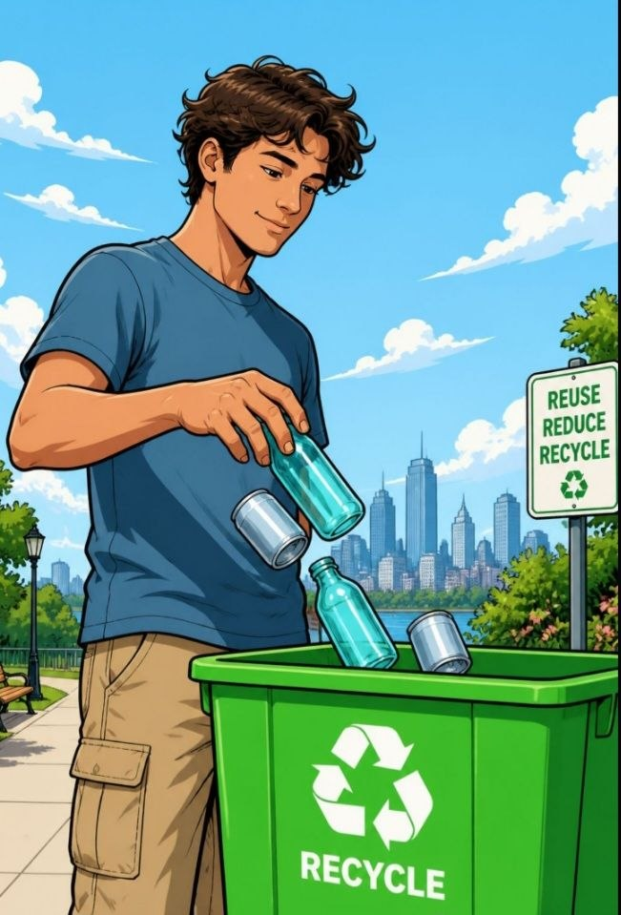
Project Overview
What the Eco Reward System is, in one look.
The Eco Reward System is a beginner-level Python application that encourages recycling by rewarding users with points for each material they recycle.
♻
It combines Object-Oriented Programming with file handling to track activity and persist data — making it a practical, real-world CS project.
2

Slide 3
Project Objectives
Five goals this system is built around.
1
2
3
Encourage Recycling
Record Activities
Auto-Calculate Points
Motivate users through a gamified point-based reward
Log every recycling event with material type and weight
Apply point rules and bonuses automatically based on input
4
5
Persist Data
Practice OOP
Store user points and history in text files for session continuity
Apply classes, methods, and encapsulation in a real project
3

Slide 4
Technologies Used
Core Python concepts applied throughout the project.
This project brings together essential Python fundamentals into one cohesive application.
1
Python 3
The primary programming language
2
OOP
Classes, objects, and methods
3
File Handling
Reading from and writing to .txt files
4
Conditionals & Loops
Control flow and user interaction
5
Functions
Modular, reusable logic blocks
4

Slide 5
System Features
The seven actions available in the program.
1
Add Recycling Activity
Log a material type and weight to earn points
2
Check Total Points
View your accumulated reward balance anytime
3
Redeem Rewards
Exchange points for available rewards or perks
4
View Activity History
Browse all past recycling events and redemptions
5
Reset Data
Clear all saved activity and points to start fresh
6
Daily Bonus
Claim an extra points bonus once every day
7
Exit Program
Gracefully close the application and save all data
5

Slide 6
Recycling Materials & Points
How many points each kilogram earns.
P
P
G
M
Plastic
Paper
Glass
Metal
10 pts / kg
5 pts / kg
8 pts / kg
12 pts / kg
Bonus: +20 points automatically added when recycled weight exceeds 5 kg
★
6

Slide 7
Data Files
Where the system stores its data.
#
points.txt
≡
history.txt
Stores the user's cumulative total reward points across sessions.
Logs every recycling activity and reward redemption with timestamps.
7

Slide 8
OOP Design
Inside the EcoRewardSystem class.
class EcoRewardSystem
__init__()
Initializes points and loads existing data from files
add_activity()
Records a new recycling event and calculates earned points
check_points()
Displays the current total reward balance
redeem_reward()
Deducts points when a reward is claimed
reset_data()
Clears all saved activity and points to start fresh
daily_bonus()
Grants an extra points bonus once every day
view_history()
Reads and prints the full activity log
8

Slide 9
Libraries Used
Python libraries powering the system.
1
os
File existence checking
2
datetime
Date management
3
collections (Counter)
Counting materials
4
random
Random daily bonus generation
5
statistics
Statistical calculations
6
colorama
Colored console output
7
tabulate
Table formatting
9

Slide 10
Program Workflow
How a session flows from start to finish.
Start
→
Show Menu
→
Choose Action
→
Perform Action
→
Save to Files
→
Exit?
The program runs in a continuous loop, presenting the menu after each action until the user chooses to exit — ensuring a smooth, interactive experience throughout the session.
10

Slide 11
Sample Output
A recycling activity with the weight bonus applied.
Choose Material: Plastic
Enter Weight (kg): 6
Points Earned: 80
(6 × 10) + 20 Bonus
Total Points: 150
★
Bonus Logic
A conditional check adds +20 points automatically whenever the recycled weight exceeds 5 kg — rewarding larger recycling efforts.
✓ Bonus applied — weight exceeded 5 kg!
11

Slide 12
Validation Challenges
Edge cases the program handles gracefully.
Invalid material
→ Handled with input re-prompting
!
Negative weight
→ Rejected with a clear error message
!
Missing files
→ Managed gracefully using try/except
!
Bonus logic
→ Conditional check for weight > 5 kg
!
12

Slide 13

Conclusion
What this project demonstrates.
♻
The Eco Reward System demonstrates how beginner-level
Python concepts — OOP, file handling, input validation,
and control flow — come together to build a meaningful,
functional application.
It's a strong foundation for any first-year CS student
ready to tackle real-world problems with code.
13

Slide 14
♻
Thank You
Questions are welcome! 🌱
14

